Slide 1
Lesson: React Native
May 27, 2022
Alpha Alimamy Kamara, B.Eng (Electrical and Electronics), M. Eng(Software Engineering)
Contact: +23277331823 / +232792299991

Slide 2
Learn the Basics
Setting up the development environment
JSX
Components
State
Props
Hooks

Slide 3
React Fundamentals
React Native runs on React, a popular open source library for building user interfaces with JavaScript.
To make the most of React Native, it helps to understand React itself.
This section can get you started or can serve as a refresher course.
If you want to dig deeper, we encourage you to check out React’s official documentation.

Slide 4
Setting up the development environment
If you are new to mobile development, the easiest way to get started is with Expo CLI.
Expo is a set of tools built around React Native and, while it has many features, the most relevant feature for us right now is that it can get you writing a React Native app within minutes.
You will only need a recent version of Node.js and a phone or emulator. If you'd like to try out React Native directly in your web browser before installing any tools, you can try out Snack.

Slide 5
Expo CLI Quick start
Running your React Native application
Install the Expo client app on your iOS or Android phone and connect to the same wireless network as your computer.
On Android, use the Expo app to scan the QR code from your terminal to open your project.
On iOS, use the built-in QR code scanner of the Camera app.

Slide 6
Setting the environment …
If you are already familiar with mobile development, you may want to use React Native CLI.
It requires Xcode or Android Studio to get started.
If you already have one of these tools installed, you should be able to get up and running within a few minutes.
If they are not installed, you should expect to spend about an hour installing and configuring them.

Slide 7
Expo CLI Quick start
Assuming that you have Node 14 LTS or greater installed, you can use npm to install the Expo CLI command line utility:
npm install -g expo-cli
yarn global add expo-cli
expo init myFirstProject
cd myFirstProject
yarn start # you can also use: expo start

Slide 8
Views and mobile development
In Android and iOS development, a view is the basic building block of UI:
A small rectangular element on the screen which can be used to display text, images, or respond to user input.
Even the smallest visual elements of an app, like a line of text or a button, are kinds of views.
Some kinds of views can contain other views.
It’s views all the way down!

Slide 9
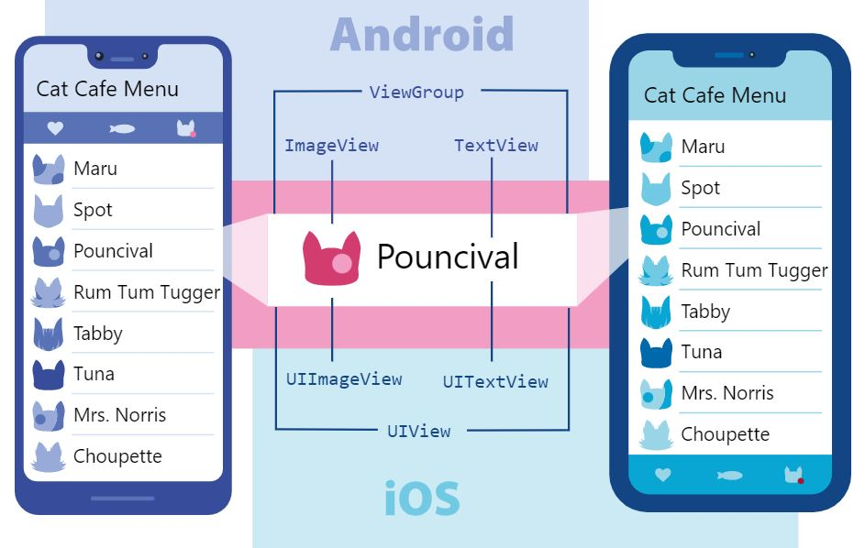
Views and mobile development

Slide 10
Native Components​
React Native comes with a set of essential, ready-to-use Native Components you can use to start building your app today.
These are React Native's Core Components.
React Native also lets you build your own Native Components for Android and iOS to suit your app’s unique needs.
React Native also has a thriving ecosystem of these community-contributed components.

Slide 11
Core Components
REACT NATIVE UI COMPONENT | ANDROID VIEW | IOS VIEW | WEB ANALOG | DESCRIPTION
<View> | <ViewGroup> | <UIView> | A non-scrollling <div> | A container that supports layout with flexbox, style, some touch handling, and accessibility controls
<Text> | <TextView> | <UITextView> | <p> | Displays, styles, and nests strings of text and even handles touch events
<Image> | <ImageView> | <UIImageView> | <img> | Displays different types of images
<ScrollView> | <ScrollView> | <UIScrollView> | <div> | A generic scrolling container that can contain multiple components and views
<TextInput> | <EditText> | <UITextField> | <input type="text"> | Allows the user to enter text

Slide 12
Your first component​
The rest of this introduction to React uses Greeting in its examples: friendly, approachable creatures that need names and a Hello to work in.
Here is your very first Hello component:

Slide 13
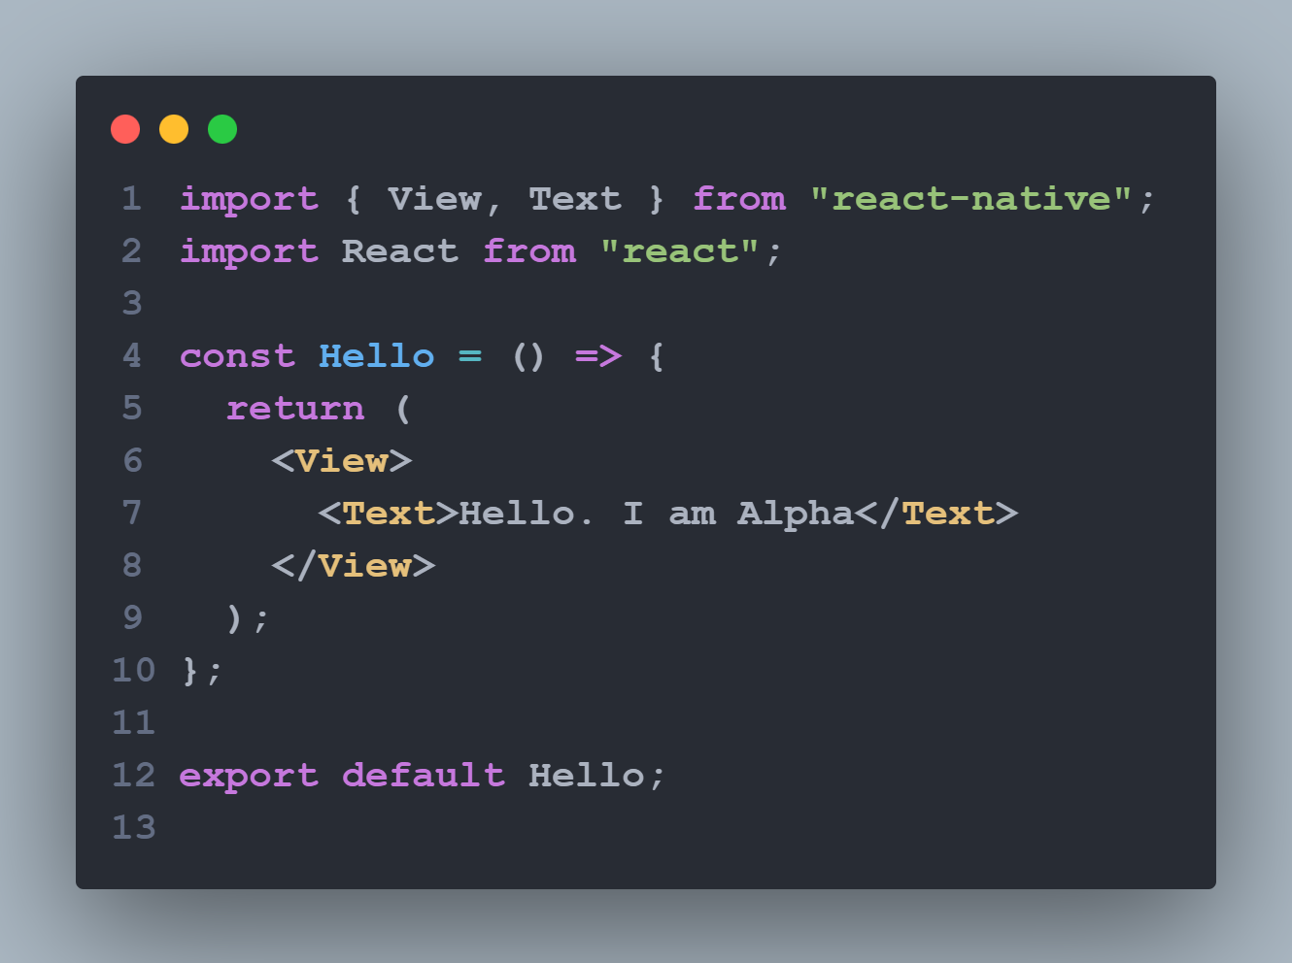
Your first component ….

Slide 14
JSX
React and React Native use JSX, a syntax that lets you write elements inside JavaScript
like so: <Text>Hello, I am Alpha</Text>
The React docs have a comprehensive guide to JSX you can refer to learn even more.
Because JSX is JavaScript, you can use variables inside it.
Here you are declaring a name for the Hello component, name, and embedding it with curly braces inside <Text>

Slide 15
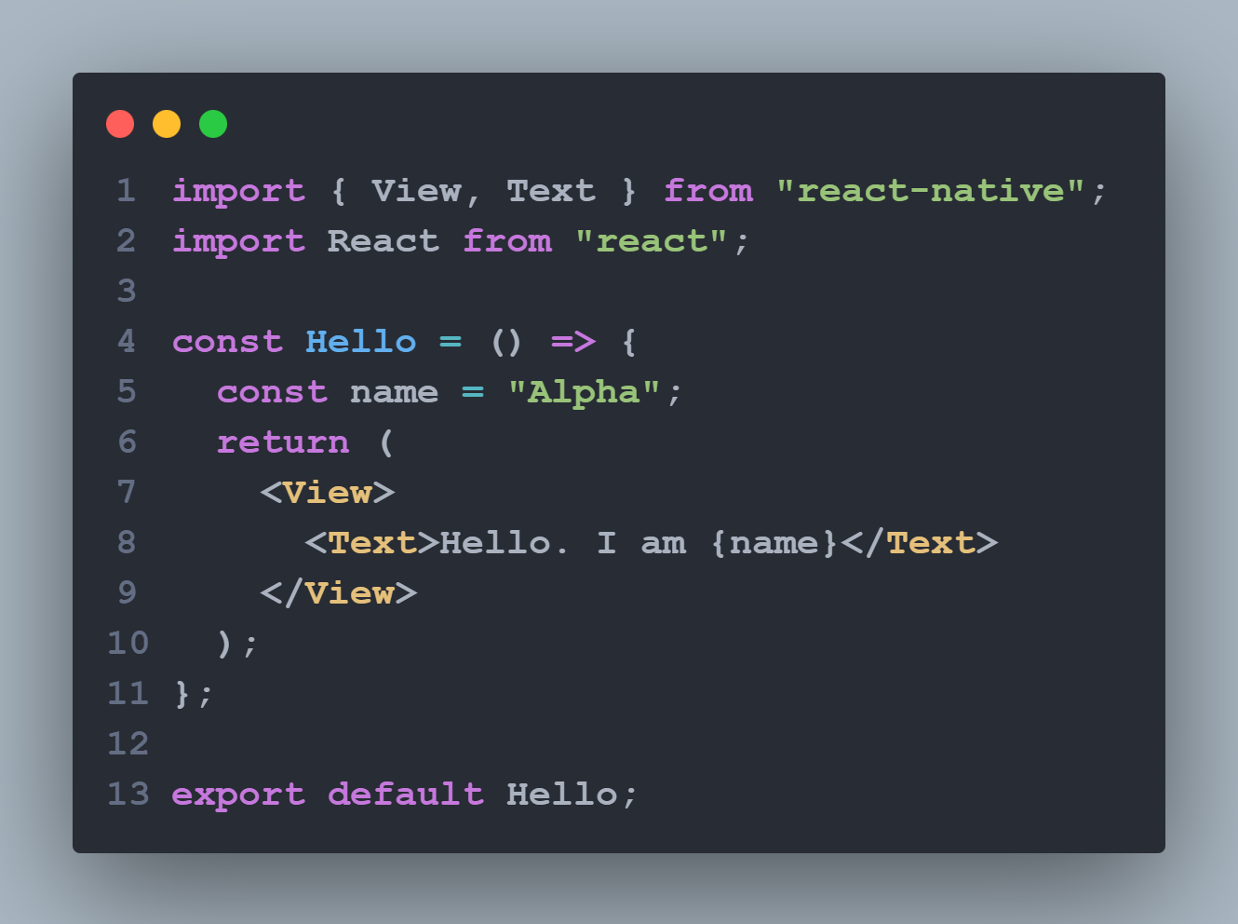
JSX

Slide 16
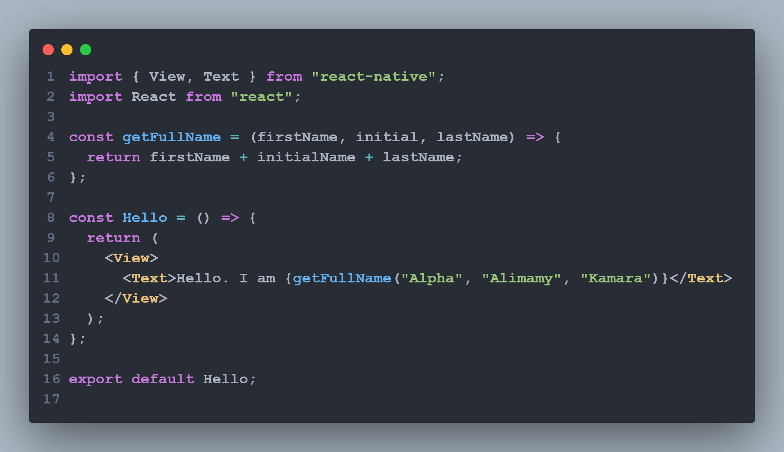
JSX continue….
Any JavaScript expression will work between curly braces, including function calls like {getFullName("Alpha", "Alimamy", "Kamara")}:

Slide 17
JSX ….
You can think of curly braces as creating a portal into JS functionality in your JSX!
Because JSX is included in the React library, it won’t work if you don’t have import React from 'react' at the top of your file!

Slide 18
Custom Components​
React lets you nest these components inside each other to create new components.
These nested, reusable components are at the heart of the React paradigm.
For example, you can nest Text and TextInput inside a View below, and React Native will render them together:

Slide 19
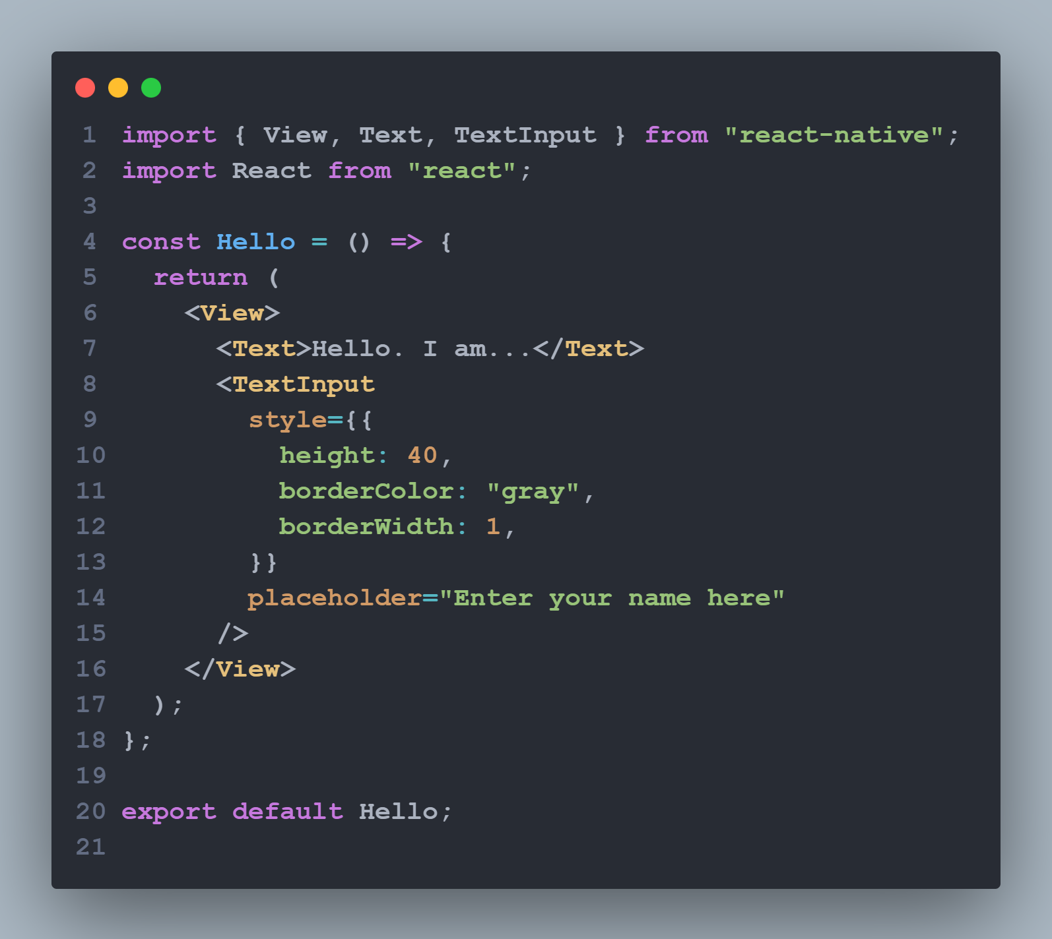
Components….

Slide 20
Custom Components​
On Android, you usually put your views inside LinearLayout, FrameLayout, RelativeLayout, etc. to define how the view’s children will be arranged on the screen.
In React Native, View uses Flexbox for its children’s layout. You can learn more in the guide to layout with Flexbox.
You can render this component multiple times and in multiple places without repeating your code by using <Hello>:

Slide 21
Custom Components​ ….
Any component that renders other components is a parent component.
Here, Hello is the parent component and each Greeting is a child component.
You can put as many Greeting in your Hello as you like.
Each <Greeting> renders a unique element—which you can customize with props.

Slide 22
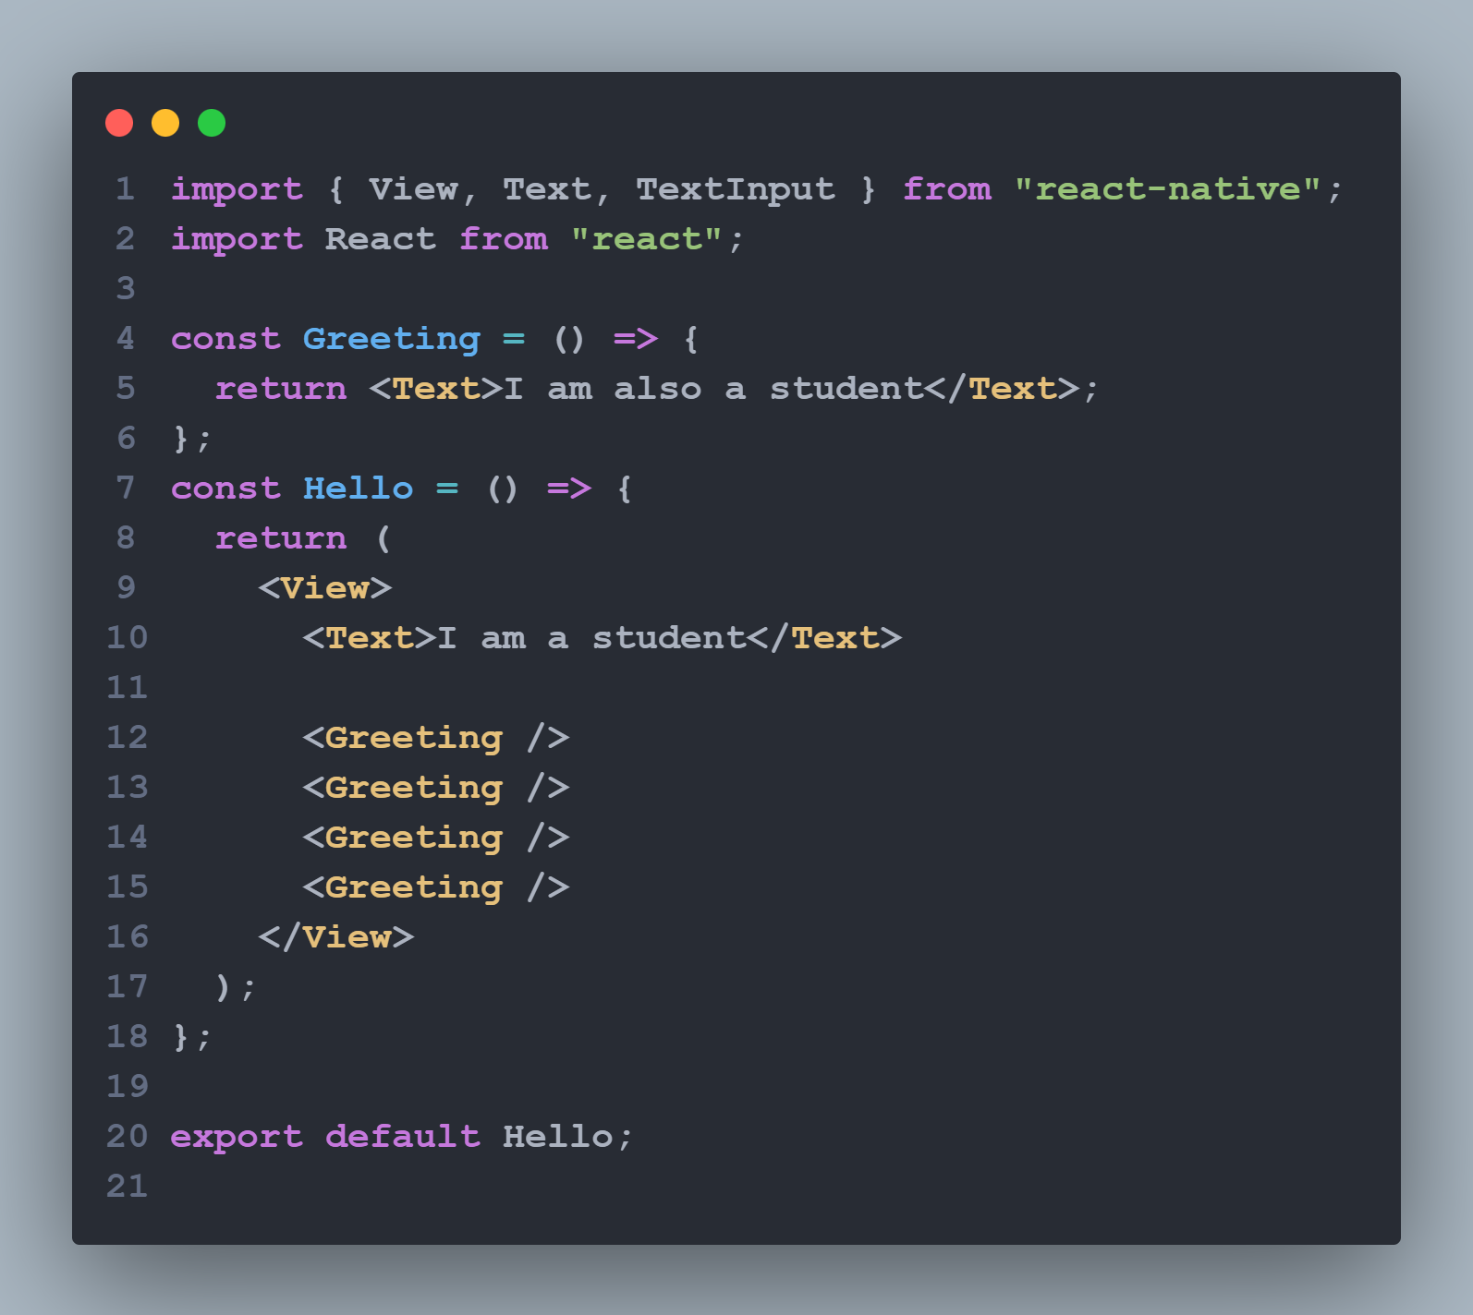
Components ​....

Slide 23
Props
Props is short for “properties”.
Props let you customize React components.
For example, here you pass each <Greeting> a different name for Greeting to render:

Slide 24
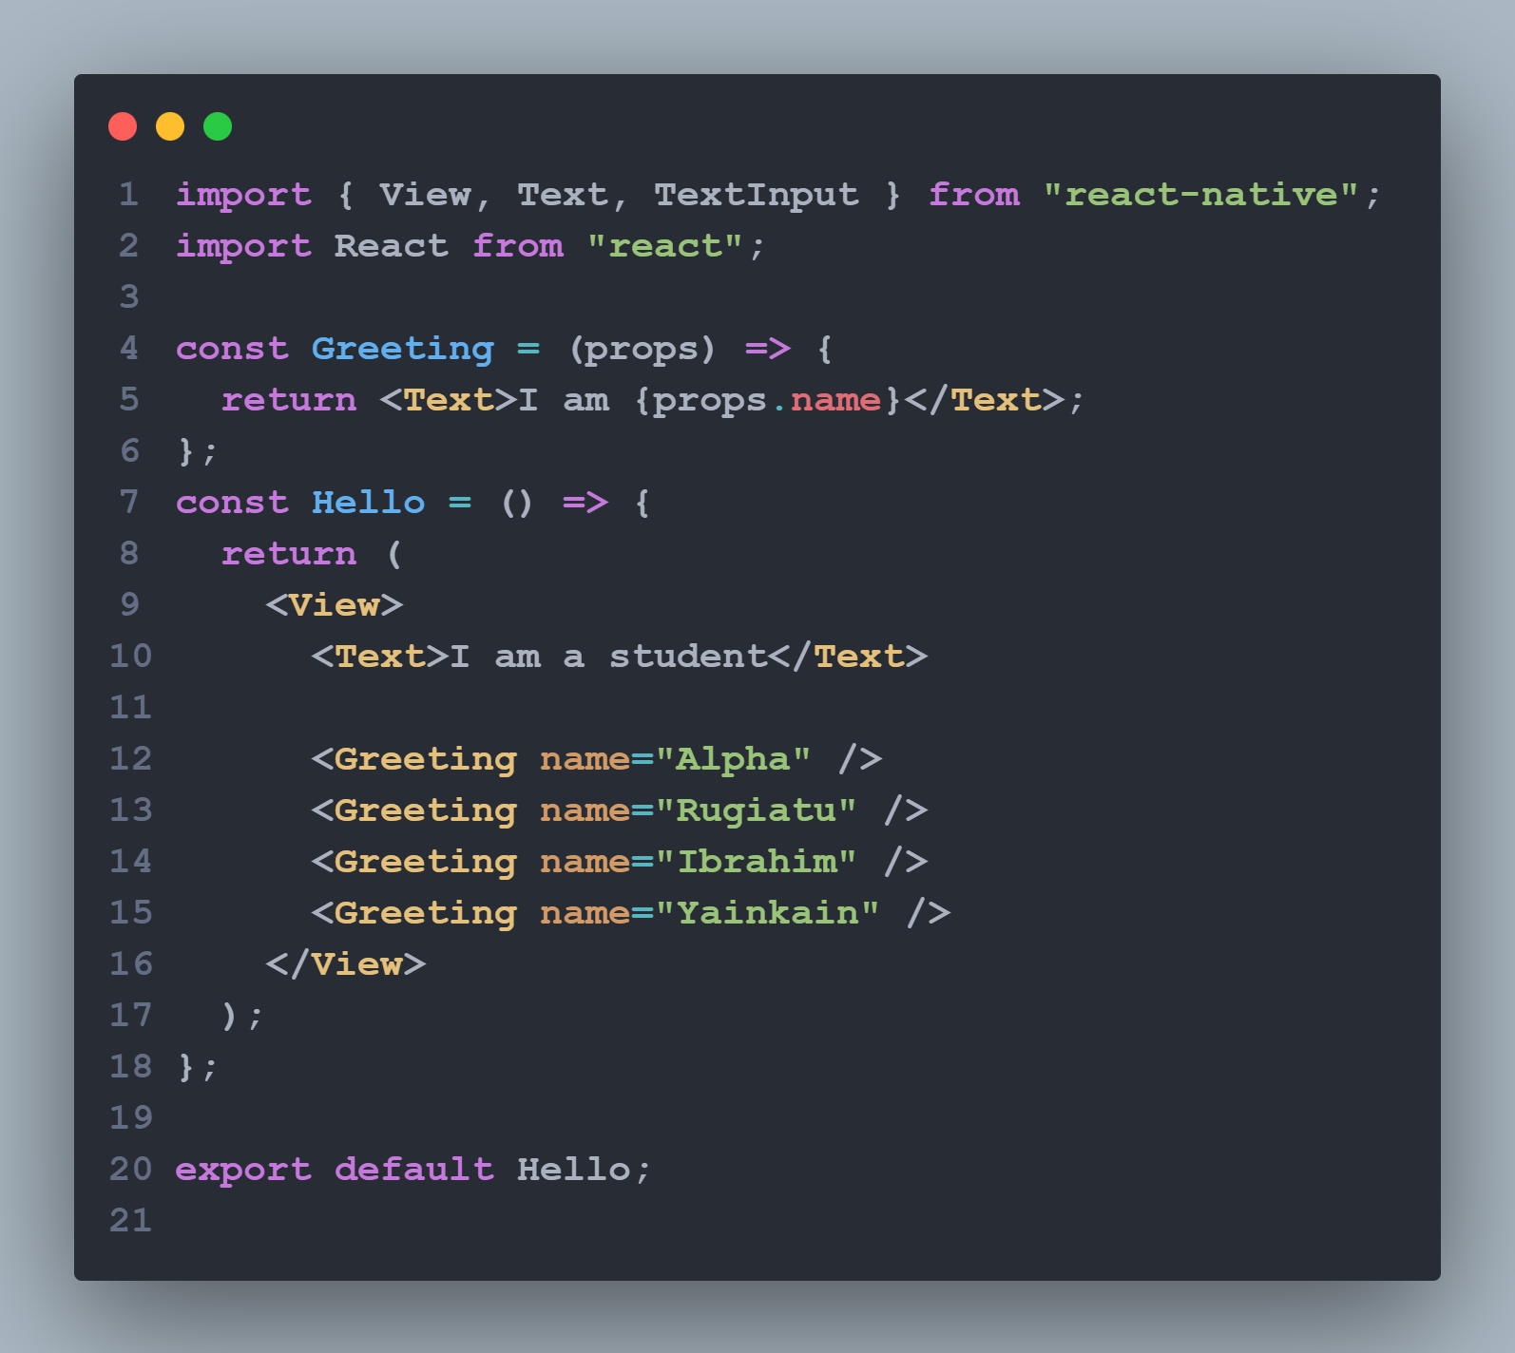
Props …..

Slide 25
Props …
Most of React Native’s Core Components can be customized with props, too.
For example, when using Image, you pass it a prop named source to define what image it shows:

Slide 26
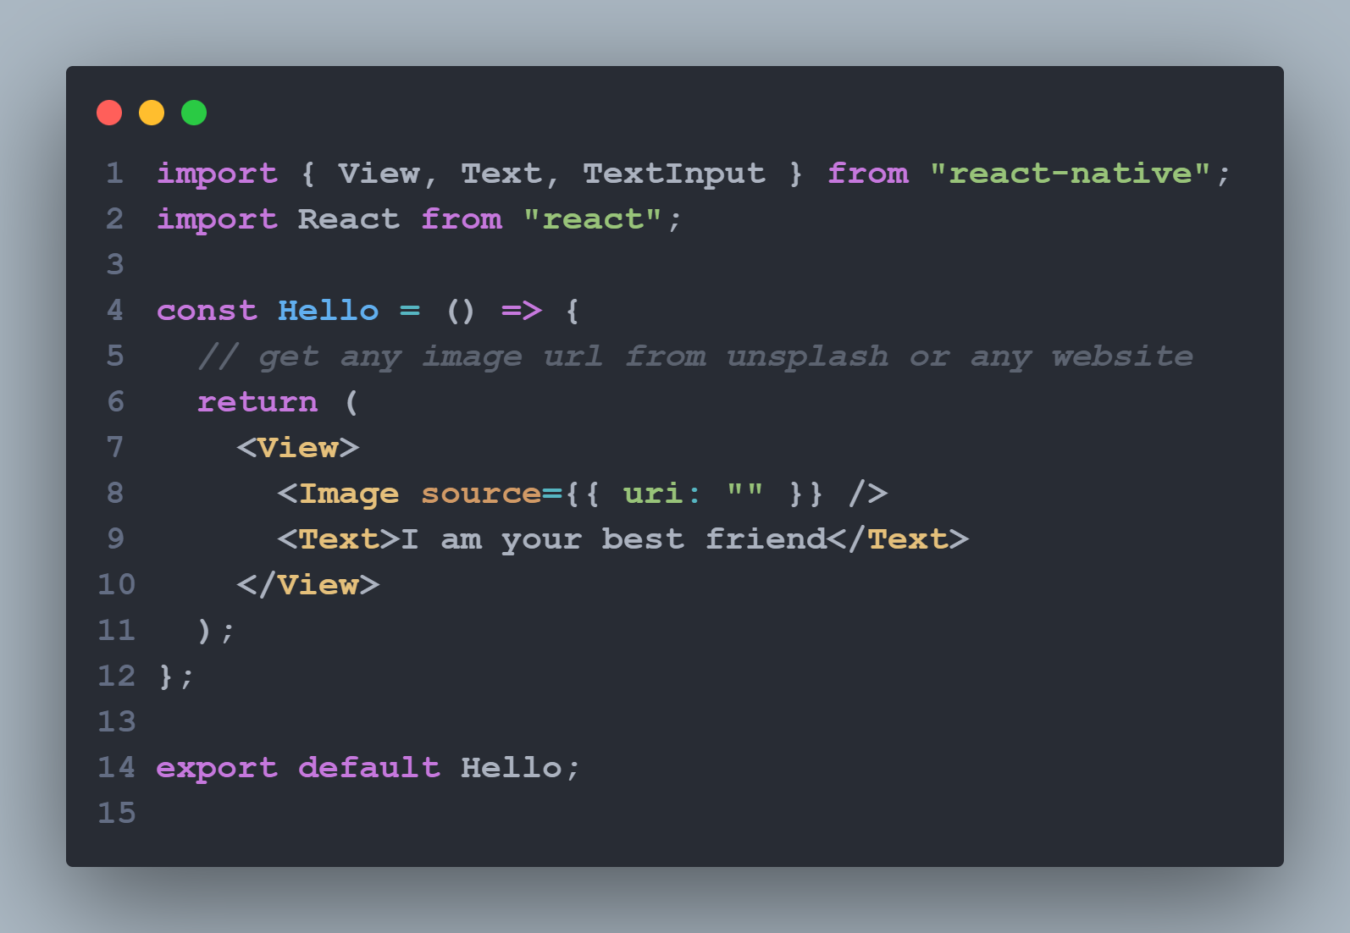
Props….

Slide 27
Props …
Image has many different props, including style, which accepts a JS object of design and layout related property-value pairs.
Notice the double curly braces {{ }} surrounding style‘s width and height. In JSX, JavaScript values are referenced with {}.
This is handy if you are passing something other than a string as props, like an array or number: <Cat food={["fish", "kibble"]} age={2} />.
However, JS objects are also denoted with curly braces: {width: 200, height: 200}.

Slide 28
Props …
Therefore, to pass a JS object in JSX, you must wrap the object in another pair of curly braces: {{width: 200, height: 200}}
You can build many things with props and the Core Components Text, Image, and View!
But to build something interactive, you’ll need state.

Slide 29
State
While you can think of props as arguments you use to configure how components render, state is like a component’s personal data storage.
State is useful for handling data that changes over time or that comes from user interaction.
State gives your components memory!
As a general rule, use props to configure a component when it renders.
Use state to keep track of any component data that you expect to change over time.

Slide 30
State ….
You can add state to a component by calling React’s useState Hook.
A Hook is a kind of function that lets you “hook into” React features.
For example, useState is a Hook that lets you add state to function components.
You can learn more about other kinds of Hooks in the React documentation.

Slide 31
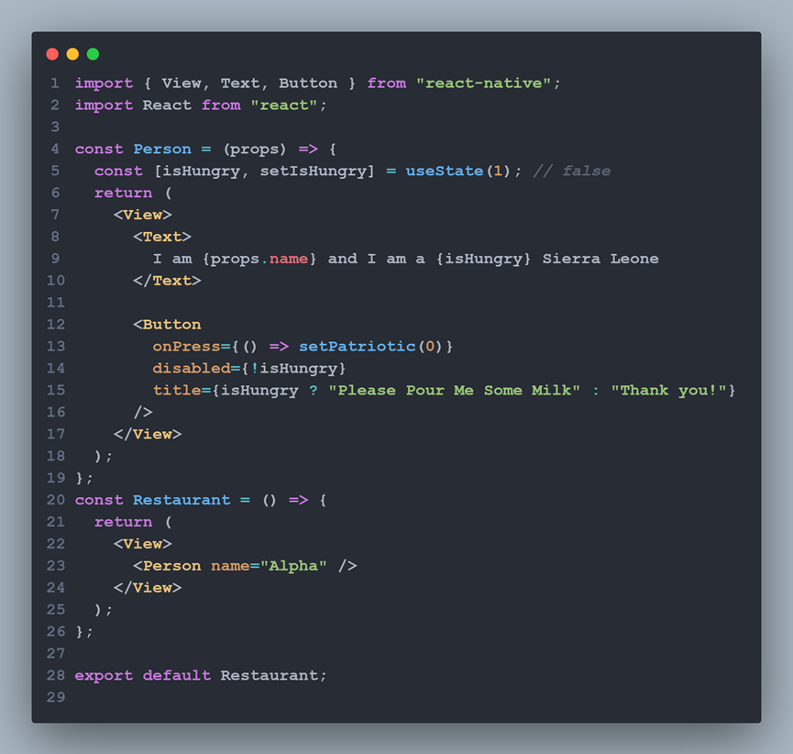
State

Slide 32
Handling Text Input
TextInput is a Core Component that allows the user to enter text.
It has an onChangeText prop that takes a function to be called every time the text changed, and an onSubmitEditing prop that takes a function to be called when the text is submitted.

Slide 33
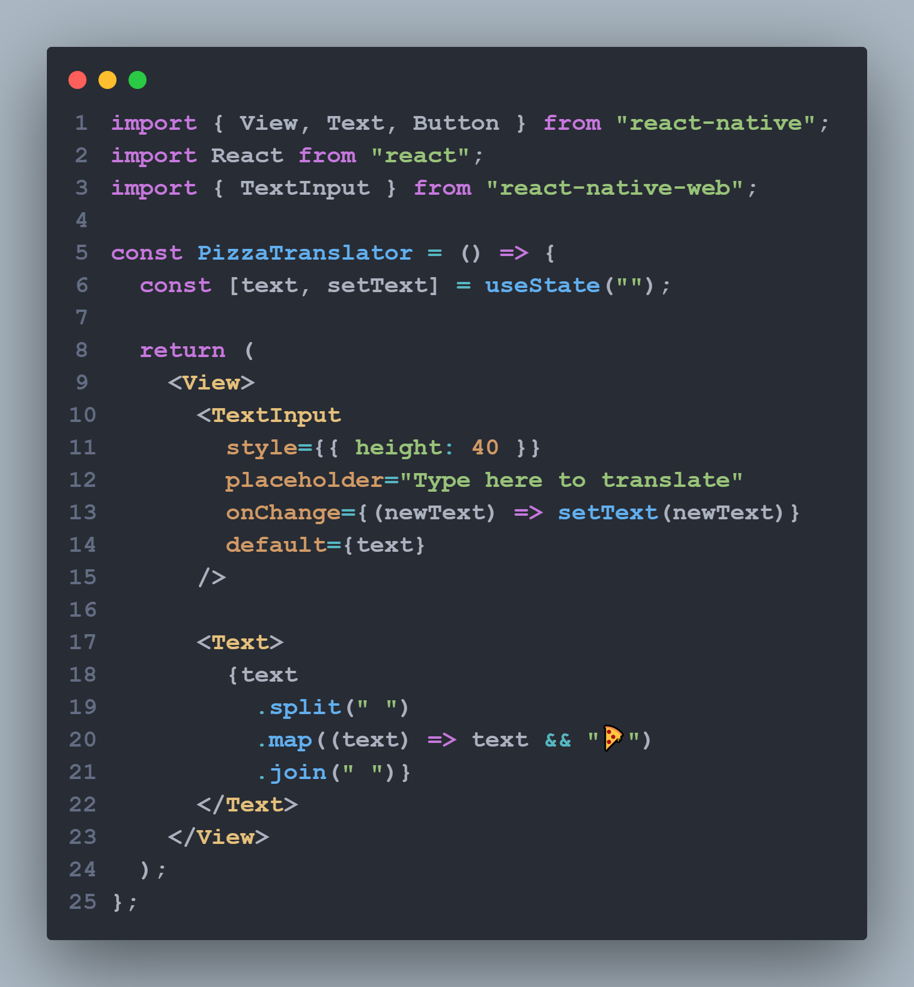
Handling Text Input

Slide 34
Handling Text Input

Slide 35
Handling Text Input

Slide 36
Views and mobile development

Slide 37
Views and mobile development

Slide 38
Views and mobile development

Slide 39
Homework

